Slide 1

INTRODUCTION TO HBASE

Slide 2
HBASE INTRODUCTION
HBase is a distributed column-oriented database built on top of the Hadoop file system.
It is an open-source project and is horizontally scalable.
HBase is a data model that is similar to Google’s big table designed to provide quick random access to huge amounts of structured data. It leverages the fault tolerance provided by the Hadoop File System (HDFS).
It is a part of the Hadoop ecosystem that provides random real-time read/write access to data in the Hadoop File System.
One can store the data in HDFS either directly or through HBase. Data consumer reads/accesses the data in HDFS randomly using HBase. HBase sits on top of the Hadoop File System and provides read and write access.

Slide 3
HDFS | HBase
HDFS is a distributed file system suitable for storing large files. | HBase is a database built on top of the HDFS.
HDFS does not support fast individual record lookups. | HBase provides fast lookups for larger tables.
It provides high latency batch processing. | It provides low latency access to single rows from billions of records (Random access).
It provides only sequential access of data. | HBase internally uses Hash tables and provides random access, and it stores the data in indexed HDFS files for faster lookups.

Slide 4
Rowid | Column Family |  |  | Column Family |  |  | Column Family |  |  | Column Family
 | col1 | col2 | col3 | col1 | col2 | col3 | col1 | col2 | col3 | col1 | col2 | col3
1
2
3

Slide 5
Column Oriented and Row Oriented
Column-oriented databases are those that store data tables as sections of columns of data, rather than as rows of data. Shortly, they will have column families.
Row-Oriented Database | Column-Oriented Database
It is suitable for Online Transaction Process (OLTP). | It is suitable for Online Analytical Processing (OLAP).
Such databases are designed for small number of rows and columns. | Column-oriented databases are designed for huge tables.

Slide 6
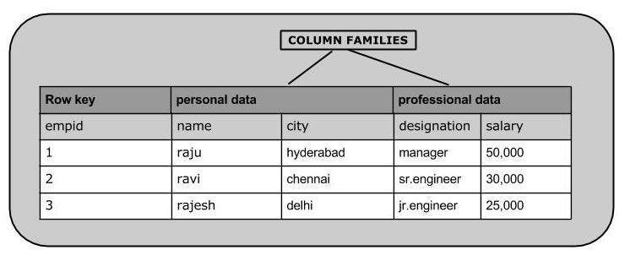

Slide 7
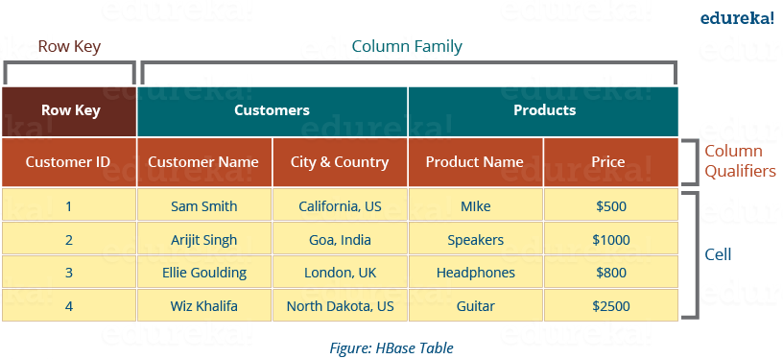

Slide 8
Tables: Data is stored in a table format in HBase. But here tables are in column-oriented format.
Row Key: Row keys are used to search records which make searches fast.
Column Families: Various columns are combined in a column family. These column families are stored together which makes the searching process faster because data belonging to same column family can be accessed together in a single seek.
Column Qualifiers: Each column’s name is known as its column qualifier.
Cell: Data is stored in cells. The data is dumped into cells which are specifically identified by rowkey and column qualifiers.
Timestamp: Timestamp is a combination of date and time. Whenever data is stored, it is stored with its timestamp. This makes easy to search for a particular version of data.

Slide 9
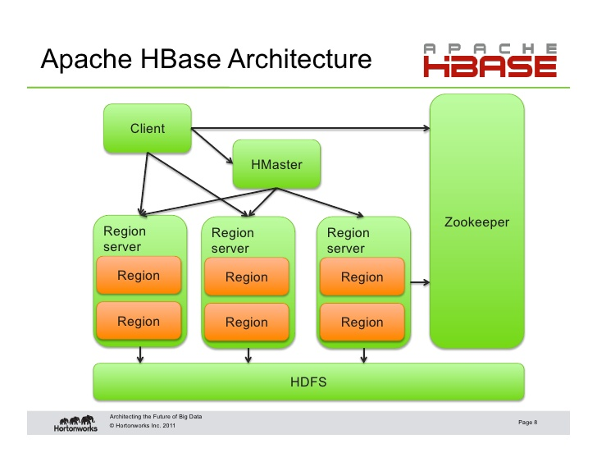

Slide 10
The HBase Architecture:
-1. Consists of servers in a Master-Slave relationship. Master node is called HMaster and the multiple Region Servers(Slaves)(collection of column families) are called HRegionServer. Each Region Server contains multiple Regions – HRegions.
-2. Data is stored in Tables which are stored in Regions(collection of column families). When a Table becomes too big, the Table is partitioned into multiple Regions.
-3. Each Region Server contains a Write-Ahead Log (called HLog) and multiple Regions. Each Region in turn is made up of a MemStore and multiple StoreFiles (HFile). The data lives in these StoreFiles in the form of Column Families . The MemStore holds in-memory modifications to the Store (data).
-4. A system table called .META - keeps the mapping of Regions to Region Server. The clients read the required Region information from the .META table and directly communicate with the appropriate Region Server.

Slide 11
HBase | RDBMS
HBase is schema-less, it doesn't have the concept of fixed columns schema; defines only column families. | An RDBMS is governed by its schema, which describes the whole structure of tables.
It is built for wide tables. HBase is horizontally scalable. | It is thin and built for small tables. Hard to scale.
No transactions are there in HBase. | RDBMS is transactional.
It has de-normalized data. | It will have normalized data.
It is good for semi-structured as well as structured data. | It is good for structured data.

Slide 12
Where to Use HBase
Apache HBase is used to have random, real-time read/write access to Big Data.
It hosts very large tables on top of clusters of commodity hardware.
Apache HBase is a non-relational database modeled after Google's Bigtable. Bigtable acts up on Google File System, likewise Apache HBase works on top of Hadoop and HDFS.

Slide 13
Applications of HBase
It is used whenever there is a need to write heavy applications.
HBase is used whenever we need to provide fast random access to available data.
Companies such as Facebook, Twitter, Yahoo, and Adobe use HBase internally.

Slide 14
HBase History
Year | Event
Nov 2006 | Google released the paper on BigTable.
Feb 2007 | Initial HBase prototype was created as a Hadoop contribution.
Oct 2007 | The first usable HBase along with Hadoop 0.15.0 was released.
Jan 2008 | HBase became the sub project of Hadoop.
Oct 2008 | HBase 0.18.1 was released.
Jan 2009 | HBase 0.19.0 was released.
Sept 2009 | HBase 0.20.0 was released.
May 2010 | HBase became Apache top-level project.

Slide 15
Working with Hbase commands
HBase general commands – Opening of the terminal
create table
list
disable
is_disabled
enable
is_enabled
Describe
Drop
put

Slide 16
11. Get
12. Delete
13. deleteall
14. scan
15. Count
16. truncate

Slide 17
Overview of SQOOP in Hadoop
Previously when there was no Hadoop or there was no concept of big data at that point in time all the data is used to be stored in the relational database management system.
But nowadays after the introduction of concepts of Big data, the data need to be stored in a more concise and effective way. Thus Sqoop comes into existence

Slide 18
So all the data which are stored in a relational database management system needed to be transferred into the Hadoop structure.
So the transfer of this large amount of data manually is not possible but with the help of Sqoop, we can able to do it.
Thus Sqoop is defined as the tool which is used to perform data transfer operations from relational database management system to Hadoop server

Slide 19
Features of the Sqoop
Parallel Import/Export
Sqoop uses the YARN framework to import and export data. This provides fault tolerance on top of parallelism.
2. Import Results of an SQL Query
Sqoop enables us to import the results returned from an SQL query into HDFS.
3. Connectors For All Major RDBMS Databases
Sqoop provides connectors for multiple RDBMSs, such as the MySQL and Microsoft SQL servers.

Slide 20
4. Kerberos Security Integration
Sqoop supports the Kerberos computer network authentication protocol, which enables nodes communication over an insecure network to authenticate users securely.
Provides Full and Incremental Load
Sqoop can load the entire table or parts of the table with a single command.

Slide 21
Sqoop Architecture
The client submits the import/ export command to import or export data.
2. Sqoop fetches data from different databases. Here, we have an enterprise data warehouse, document-based systems, and a relational database. We have a connector for each of these; connectors help to work with a range of accessible databases.
3. Multiple mappers perform map tasks to load the data on to HDFS

Slide 22
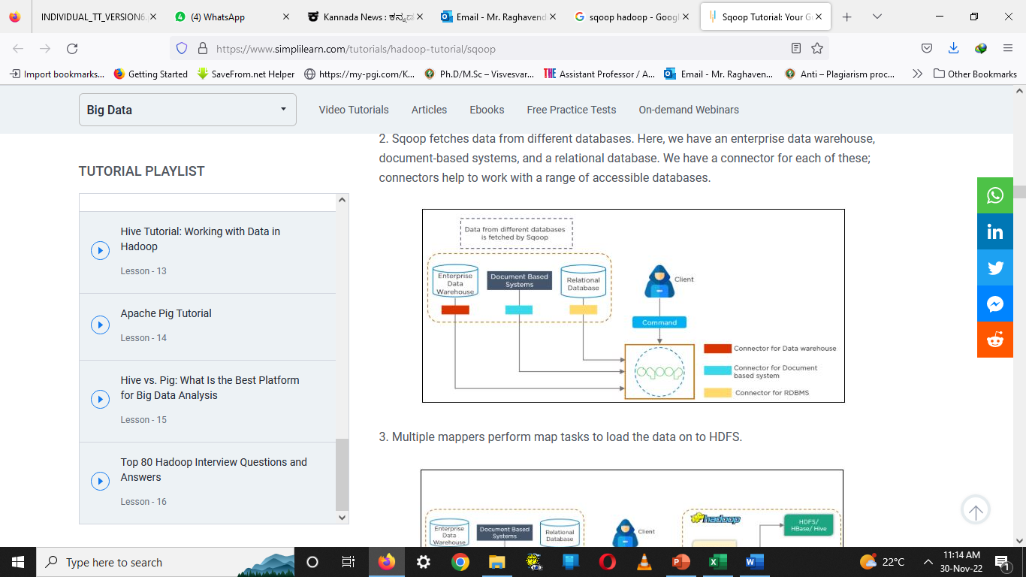


Slide 23
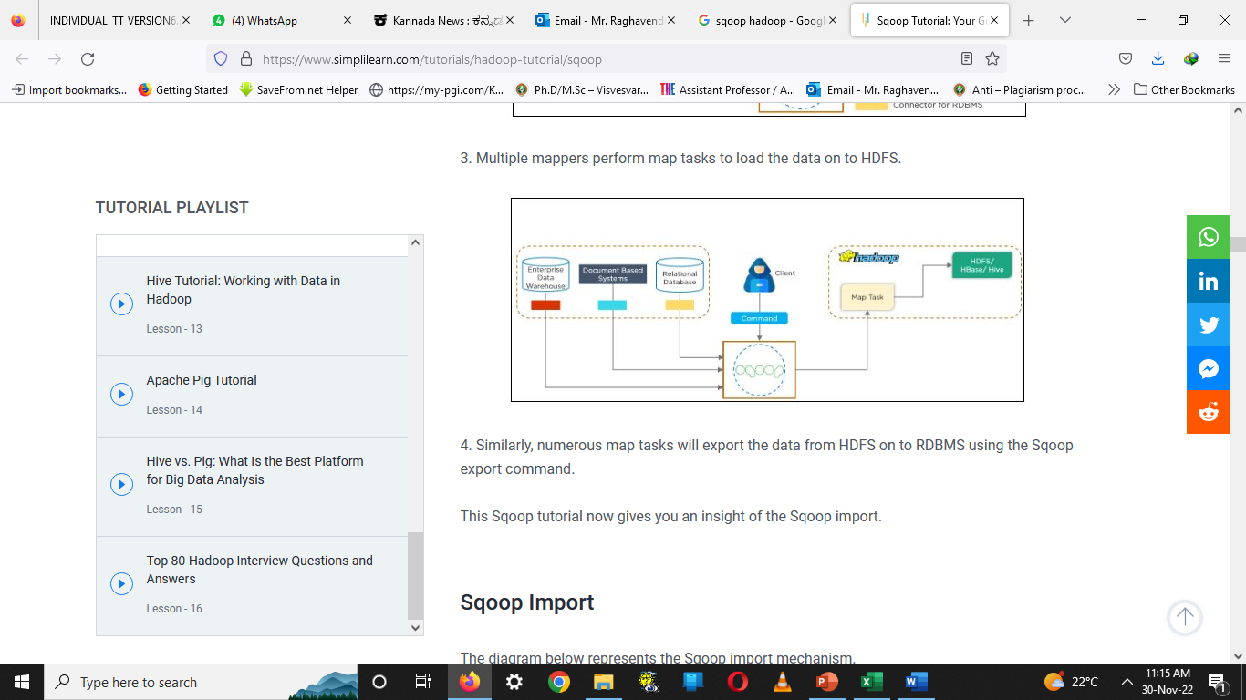

Slide 24
4. Similarly, numerous map tasks will export the data from HDFS on to RDBMS using the Sqoop export command.

Slide 25
Sqoop - Import All Tables
A tool which imports a set of tables from an RDBMS to HDFS is what we call the Sqoop import all tables.
Basically, here in HDFS, data from each table is stored in a separate directory.
Each table data is stored in a separate directory and the directory name is same as the table name.

Slide 26
Syntax
The following syntax is used to import all tables.
$ sqoop import-all-tables (generic-args) (import-args)
$ sqoop-import-all-tables (generic-args) (import-args)

Slide 27
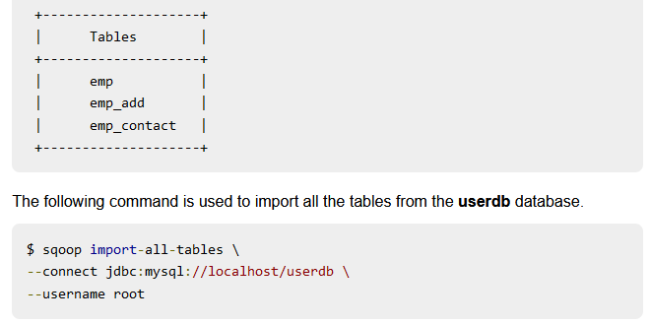
Example
Let us take an example of importing all tables from the userdb database. The list of tables that the database userdb contains is as follows.

Slide 28
If you are using the import-all-tables, it is mandatory that every table in that database must have a primary key field.
The following command is used to verify all the table data to the userdb database in HDFS.
$ $HADOOP_HOME/bin/hadoop fs -ls

Slide 29
Sqoop Export
A tool which exports a set of files from HDFS back to RDBMS. That tool is what we call a Sqoop Export Tool.
There is one condition for it, that in the database, target the table must already exist.
However, the input files are read and parsed according to the user-specified delimiters into a set of records.

Slide 30
The export command works in two modes- insert mode and update mode.
Insert mode: It is the default mode. In this mode, the records from the input files are inserted into the database table by using the INSERT statement.
2. Update mode: In the update mode, Sqoop generates an UPDATE statement that replaces existing records into the database.

Slide 31
The Syntax for Sqoop Export are:
$ sqoop export (generic-args) (export-args)
$ sqoop-export (generic-args) (export-args)

Slide 32
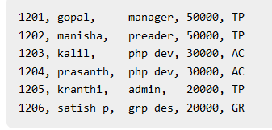
Example
Let us take an example of the employee data in file, in HDFS. The employee data is available in emp_data file in ‘emp/’ directory in HDFS. The emp_data is as follows.
It is mandatory that the table to be exported is created manually and is present in the database from where it has to be exported.

Slide 33
The following command is used to export the table data (which is in emp_data file on HDFS) to the employee table in db database of Mysql database server.
$ sqoop export \
--connect jdbc:mysql://localhost/db \
--username root \
--table employee \
--export-dir /emp/emp_data

Slide 34
Importing data from MySQL to HDFS
In order to store data into HDFS, we make use of Apache Hive which provides an SQL-like interface between the user and the Hadoop distributed file system (HDFS) which integrates Hadoop. We perform the following steps:
Step 1: Login into MySQL
Step 2: Create a database and table and insert data.
Step 3: Create a database and table in the hive where data should be imported

Slide 35
Step 4: Run below the import command on Hadoop.
sqoop import --connect \
jdbc:mysql://127.0.0.1:3306/database_name_in_mysql \
--username root --password cloudera \
--table table_name_in_mysql \
--hive-import --hive-table database_name_in_hive.table_name_in_hive \
--m 1
Step 5: Check-in hive if data is imported successfully or not.

Slide 36
SQOOP VS FLUME
Apache Sqoop | Apache Flume
Apache Sqoop is basically designed to work with any type of Relational database system (RDBMS) which has the basic JDBC connectivity. Apache Sqoop can import data from NoSQL databases like MongoDB, Cassandra and along with it also allow data transfer to Apache Hive or HDFS. | Apache Flume works pretty well in Streaming data sources that are generated continuously in Hadoop environments, such as log files
Apache Sqoop load is not driven by events | Apache Flume data loading is completely event-driven
Apache Sqoop will be considered an ideal fit if the data is being available in Teradata, Oracle, MySQL, PostgreSQL or any other JDBC compatible database | Apache Flume is considered the best choice when we are talking about moving bulk streaming data from sources likes JMS or Spooling directories
HDFS is the destination for importing data in Apache Sqoop | Data is said to flow to HDFS through channels in Apache Flume

Slide 37
Apache Sqoop has a connector based architecture, which means the connectors know a great deal in connecting with the various data sources and also to fetch data correspondingly | Apache Flume has agent-based architecture, that means code written in Flume is known as an agent that will be held responsible for fetching the data
Apache Sqoop connectors are designed specifically to work with structured data sources and to fetch data from them alone. | Apache Flume is specifically designed to fetch streaming data like tweets from Twitter or log files from Web servers or Application servers etc.
Apache Sqoop is specifically used for Parallel data transfers, data imports as it copies the data pretty quick | Apache Flume is specifically used for collecting and aggregating data because of its distributed, reliable nature, and also because of its highly available backup routes.

